Slide 1
AZ-104T00A Module 12: Azure Services

Slide 2
Module Overview
Lesson 01: Azure Bastion
Lesson 02: Module 12 Lab-A and Review​
Lesson 03: Azure AD Domain Services
Lesson 04: Module 12 Lab-B and Review​
Notes:
Module overview

Slide 3
Lesson 01: Azure Bastion

Slide 4
Azure Bastion Overview
Benefits
SKUs
Architecture
Notes:
Lesson overview

Slide 5
Benefits
Bastion is a service that lets you connect to a virtual machine using your browser and the Azure portal.
Bastion is a fully platform-managed PaaS service that you provision inside your virtual network.
Bastion provides secure RDP and SSH connectivity to all of the VMs in the virtual network in which it is provisioned.
Bastion protects your virtual machines from exposing RDP/SSH ports to the outside world, while still providing secure access using RDP/SSH. You don't need a public IP on your virtual machine.
Notes:
Infrastructure as a Service - https://azure.microsoft.com/en-us/overview/what-is-iaas/

Slide 6
SKUs
Feature | Basic SKU | Standard SKU
Connect to target VMs in peered virtual networks | Available | Available
Access Linux VM Private Keys in Azure Key Vault (AKV) | Available | Available
Host scaling | N/A | Available
Specify custom inbound port | N/A | Available
Connect to Linux VM using RDP | N/A | Available
Connect to Windows VM using SSH | N/A | Available
Notes:
Infrastructure as a Service - https://azure.microsoft.com/en-us/overview/what-is-iaas/

Slide 7
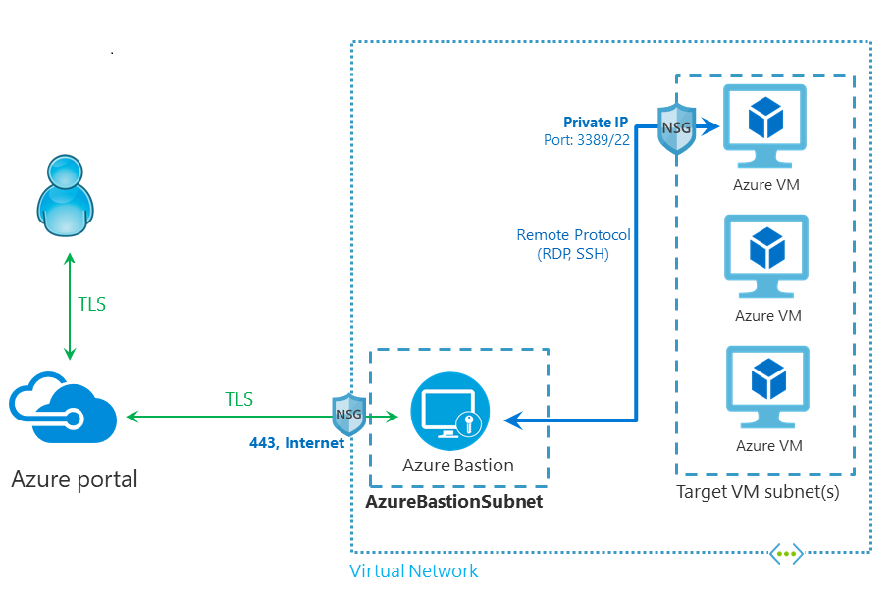
Architecture
The Bastion host is deployed in the virtual network that contains the AzureBastionSubnet subnet that has a minimum /26 prefix.
The user connects to the Azure portal using any HTML5 browser.
The user selects the virtual machine to connect to.
With a single click, the RDP/SSH session opens in the browser.
No public IP is required on the Azure VM.
Notes:
Infrastructure as a Service - https://azure.microsoft.com/en-us/overview/what-is-iaas/

Slide 8
Lesson 02: Module 08 Lab-A and Review

Slide 9
Lesson 03: Azure AD Domain Services (Azure AD DS)

Slide 10
Azure AD Domain Services
What is Azure AD DS?
How does Azure AD DS work?
Azure AD DS features and benefits
Compare Self-managed AD DS and Azure AD DS
Compare AAD and Azure AD DS
Notes:
Lesson overview

Slide 11
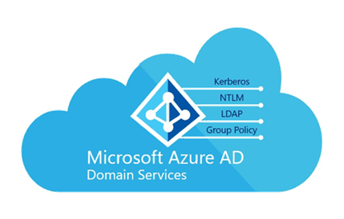
What is Azure AD DS
Azure Active Directory Domain Services (Azure AD DS) provides managed domain services such as domain join, group policy, lightweight directory access protocol (LDAP), and Kerberos/NTLM authentication. You use these domain services without the need to deploy, manage, and patch domain controllers (DCs) in the cloud.
Notes:
Lesson overview

Slide 12
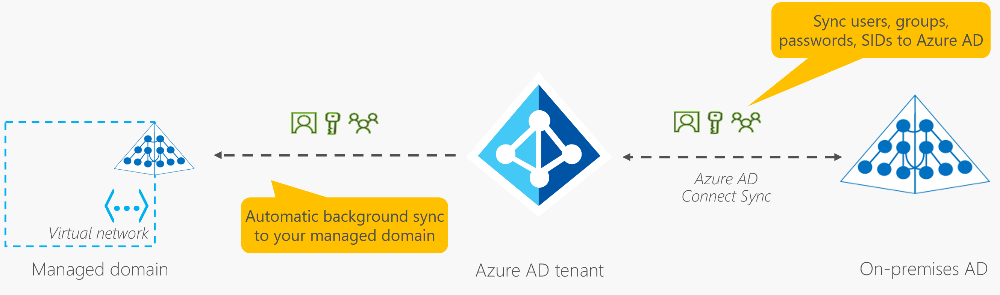
How does Azure AD DS work?
Azure AD DS define a unique namespace, such as contoso.com
Two DCs are then deployed in the azure region selected.
The DCs works as replica set.
The Azure platform handles the DCs, including backups, encryption and DFSR.
Azure AD DS allow trust relationship with on-premise AD DS environment
Notes:
Lesson overview

Slide 13
Azure AD DS features and benefits
Simplified deployment experience.
Integrated with Azure AD using the Azure AD Connect.
Use your corporate credentials/passwords.
NTLM and Kerberos authentication.
High availability.
Azure AD DS is a stand-alone domain, is not an extension of an on-premises domain.
The DCs does not need be managing, patching or monitoring.
Notes:
Lesson overview

Slide 14
Compare Self-managed AD DS and Azure AD DS
Feature | Azure AD DS | Self-managed AD DS
Managed service | √ | X
Secure deployments | √ | Admins secures the deployment
DNS server | √ | √
Domain or Enterprise administrator privileges |  | √
Domain join | √ | √
Domain authentication using NTLM and Kerberos | √ | √
Kerberos constrained delegation | Resource-based | Resource-based & account-based
Custom OU structure | √ | √
Group Policy | √ | √
Notes:
Lesson overview

Slide 15
Compare Self-managed AD DS and Azure AD DS
Feature | Azure AD DS | Self-managed AD DS
Schema extensions | X | √
AD domain / forest trusts | One-way outbound | √
Secure LDAP (LDAPS) | √ | √
LDAP read | √ | √
LDAP write | √ | √
Geo distributed deployments | √ | √
Notes:
Lesson overview

Slide 16
Compare AAD and Azure AD DS
Feature | Azure AD | Azure AD DS
Device controlled by | Azure AD | Azure AD DS managed domain
Representation in the directory | Device objects in the Azure AD directory | Computer objects in the Azure AD DS managed domain
Authentication | OAuth / OpenID Connect based protocols | Kerberos and NTLM protocols
Management | Mobile Device Management (MDM) software like Intune | Group Policy
Networking | Works over the internet | Must be connected to, or peered with, the virtual network where the managed domain is deployed
Great for… | End-user mobile or desktop devices | Server VMs deployed in Azure
Notes:
Lesson overview

Slide 17
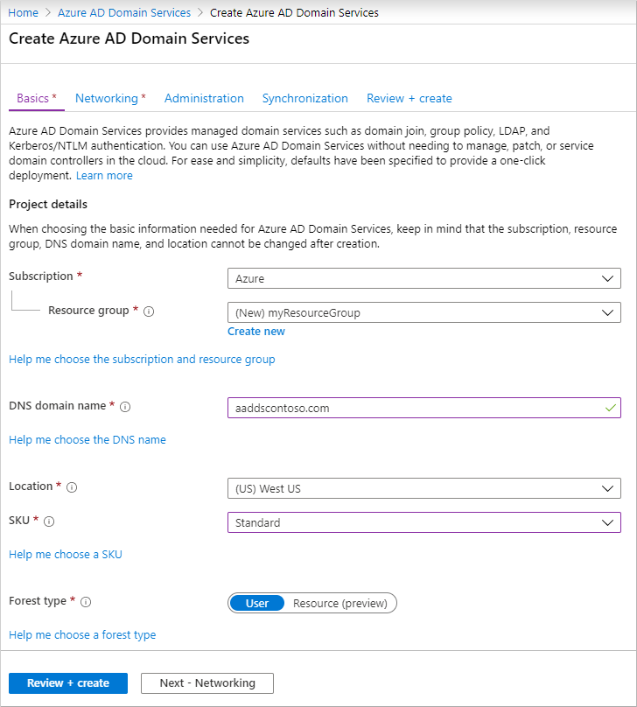
Creating an Azure AD DS
DNS domain name
Azure Location
SKU
Standard
Enterprise
Premium
Forest type

Slide 18
Lesson 04: Module 12 Labs-B and Review

